Slide 1
Elasticsearch short introduction

Slide 2
https://github.com/jakubgw/elasticsearch-short-intruduction
Docker compose with elasticsearch cluster working on two nodes
Sample collections data to insert
Postman collection with all calls
This presentation ☺

Slide 3
Elasticsearch is a highly scalable open-source full-text search and analytics engine. Allows you to store, search, and analyze big volumes of data quickly and in near real time.
Notes:
As you will continue to use both your Avanade and Infusion accounts for some period of time, you must also ensure that you are using good password hygiene on your Infusion account. Make sure your Infusion account password is set to one that is not used anywhere else. You may choose to use/sync your new, strong Avanade password or passphrase on your Infusion account to have one corporate password so long as this password is not used anywhere else, though ideally this would be different as well.

Slide 4
Uses cases
NoSQL database + fulltext search – ex. web store that provides near to realtime search for whole inventory
Log analize and mining, check for trends, statistics, summarizations, or anomalies. Search + aggregations
Analitics and bussiness inteligance - quick investigation, analyze and visualization milions or bilons of records. Elastic + kibana, plugin which works on top of the index and provides visulization capabilities
Spatial queries, search for the nearest point, search for the polygons which contains point, create cluster aggregations

Slide 5
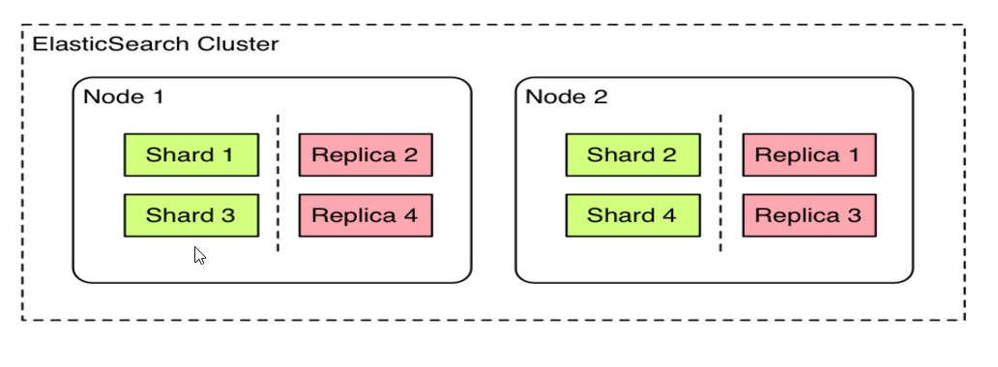
Architecture – basic concepts
A cluster is a collection of one or more nodes (servers) that together holds entire data and provides indexing and search capabilities across all nodes.

Slide 6
Architecture – basic concepts
Index – single collection of documents
Shard - index can be bigger than one server
shards solve problem of horizontal scalling
allsows distribute and paralize
Under the hood each shard is a Lucene index
Replica – copy of the shard
provides high avability, if any shard fail
allows scale out search throughput - searches can be executed on all replicas in parallel.

Slide 7
Full text search – demo
Shakespere index – contains dialogs for 36 plays
How to find „to be or not to be” dialouge in ~ 20 miliseconds
POST /shakespeare/_search?size=10
HTTP/1.1Host: localhost:9200
Content-Type: application/json
{
"query": {
"match": {
"text_entry": "to be or not to be"
}
}
}

Slide 8
Inverted index
Data structure at the heart of the each search algorithm, hashmap that directs from the word to the document index
Get the document
Tokenize text into single worlds
Normalize, lowercase, remove punctioations, special characters and other noises
Analize worlds, depends on needs for example :
To find endinds reverse "fantastic" → "citsatnaf„
To find substrings build n-grams „ yours" → "^yo", "you", "our", "urs", "rs$„
To finds cooridante points create heo hashes (60.6384, 6.5017) → „u4u8gyykk”
Sort and put into dictionary

Slide 9
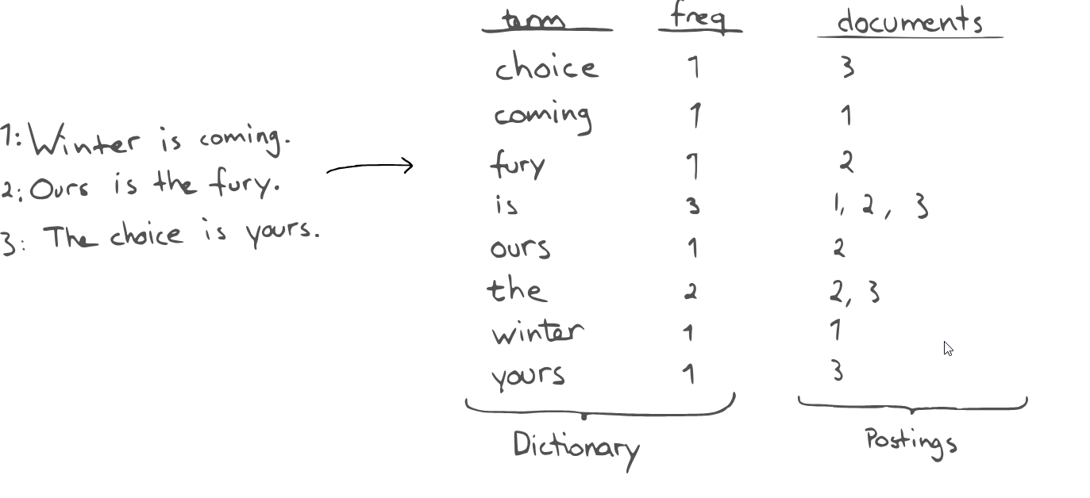

Slide 10
Scoring calculations
Inverted index is used for finding documents but also scorring calculation – to put results in the correct order
Term Frequency - how often does the term appear in this document ? more often, score is higher
Inverse Document Frequency - how often does each term appear in all documents in the index? The more often, score is lower
Field-length norm – how long is the field? The longer it is, the less likely it is that words in the field will be relevant
Use explain query paramter to get details
localhost:9200/shakespeare/_search?explain=true

Slide 11
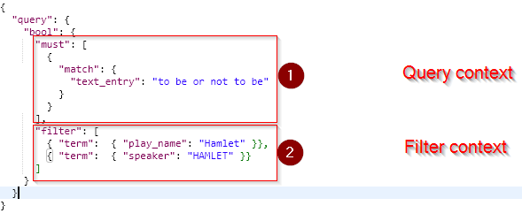
Speed up search – filters
Produces boolean outcome, without scorring
Frequently used for filtering structured data, like single terms, ranges etc
If request contains query and filters
First filters are applied
After it, on data which left, query with scorring is applied
Frequently used filters are cached

Slide 12
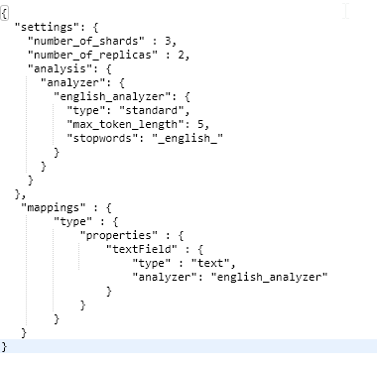
CRUD – create index
PUT /test HTTP/1.1
Host: localhost:9200

Slide 13
CRUD – create document
POST – auto generated id
PUT – option to manually create id
POST /test/type HTTP/1.1
Host: localhost:9200
Content-Type: application/json
{ "textField" : "This is text field"}

Slide 14
CRUD – delete document
DELETE /test/type/G8qPzGQB6Ajb09J74sPs HTTP/1.1
Host: localhost:9200

